Slide 1
PLACE your logo here

Slide 2
Disclaimer: The purpose of this tailorable deck is to educate the field about the importance of aligned messaging and provide an overview of the nation’s 988 Messaging Framework. Please do not use the images in this deck for other purposes.
Recommendation: We encourage the user of this presentation to tailor the presentation, as appropriate, such as adding your logo or other relevant information to meet the needs of the audience(s).

Slide 4
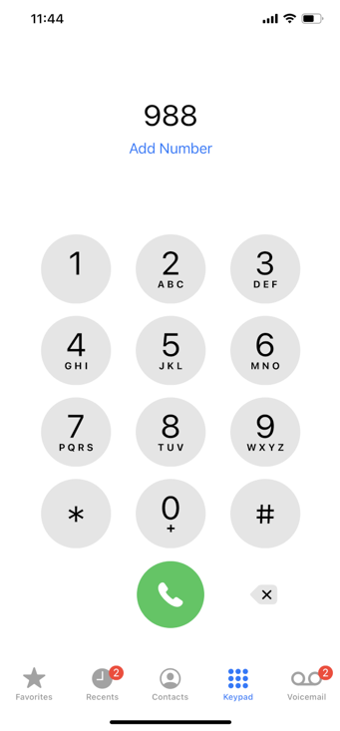
Moving the U.S. to a 3-digit Dialing Code
988
In July of 2022, our nation moved to the first-ever 3-digit dialing code for suicide prevention and mental health crises.
Fast Facts about 988:
It provides greater access to 24/7 confidential and life-saving services.
It does not replace the existing National Suicide Prevention Lifeline– but in fact strengthens and expands it.
It is an easy-to-remember number that helps to provide direct connection to compassionate, accessible care.
It’s more than just a 3-digit number, and it will strengthen our larger crisis care system.
Aligning our Messaging about 988: The Nation’s 988 Messaging Framework
4

Slide 5
We Must Equip our Messengers Now
Key Takeaway
We must educate the nation about 988 so they can utilize this lifesaving resource!
Most Americans are completely unaware of what 988 even is. However, most are in favor of crisis call centers.
17%
90%
Just
But
of those surveyed are familiar with 988.
support creating 24/7 mental health, alcohol/drug, and suicide crisis call centers that can respond effectively to callers and follow-up later
https://www.nami.org/Support-Education/Publications-Reports/Survey-Reports/Poll-of-Public-Perspectives-on-988-Crisis-Response-2023
Aligning our Messaging about 988: The Nation’s 988 Messaging Framework
5

Slide 6
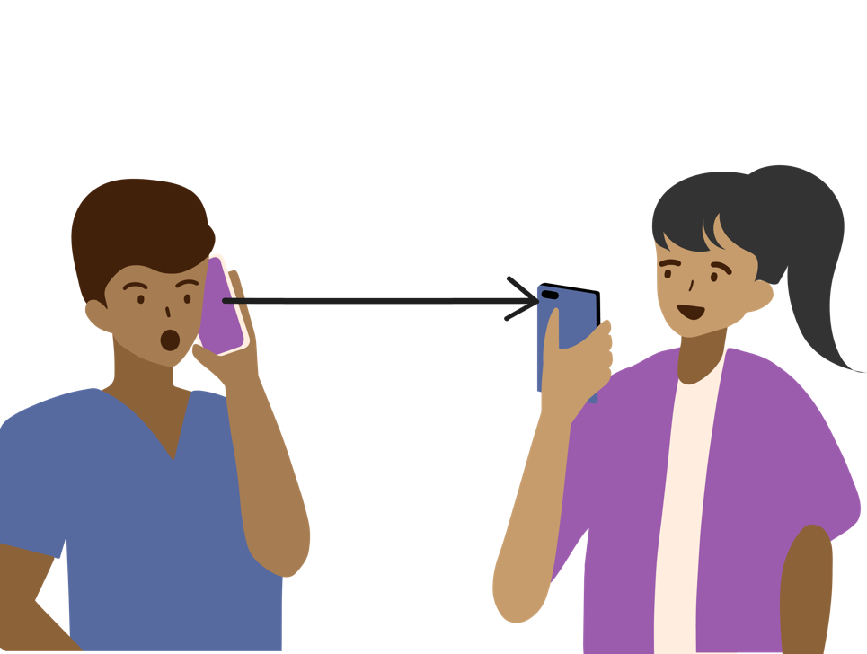
Aligned Messaging Is Critical to 988 Success
Key Takeaway Aligned and consistent messaging is key to ensure public clarity—and avoid confusion.
Misaligned/Fragmented Messaging about 988
Aligned/Coordinated Messaging about 988
Aligning our Messaging about 988: The Nation’s 988 Messaging Framework
6
6

Slide 8
Why a Messaging Framework?
Need
The field—through the National Action Alliance for Suicide Prevention’s Mental Health & Suicide Prevention National Response to COVID-19—identified an immediate and pressing need to ensure messaging alignment around 988.
Solution
Development of a well-informed 988 Messaging Framework will help ensure consistent, coordinated, and accurate messaging from the field.
Aligning our Messaging about 988: The Nation’s 988 Messaging Framework
8

Slide 9
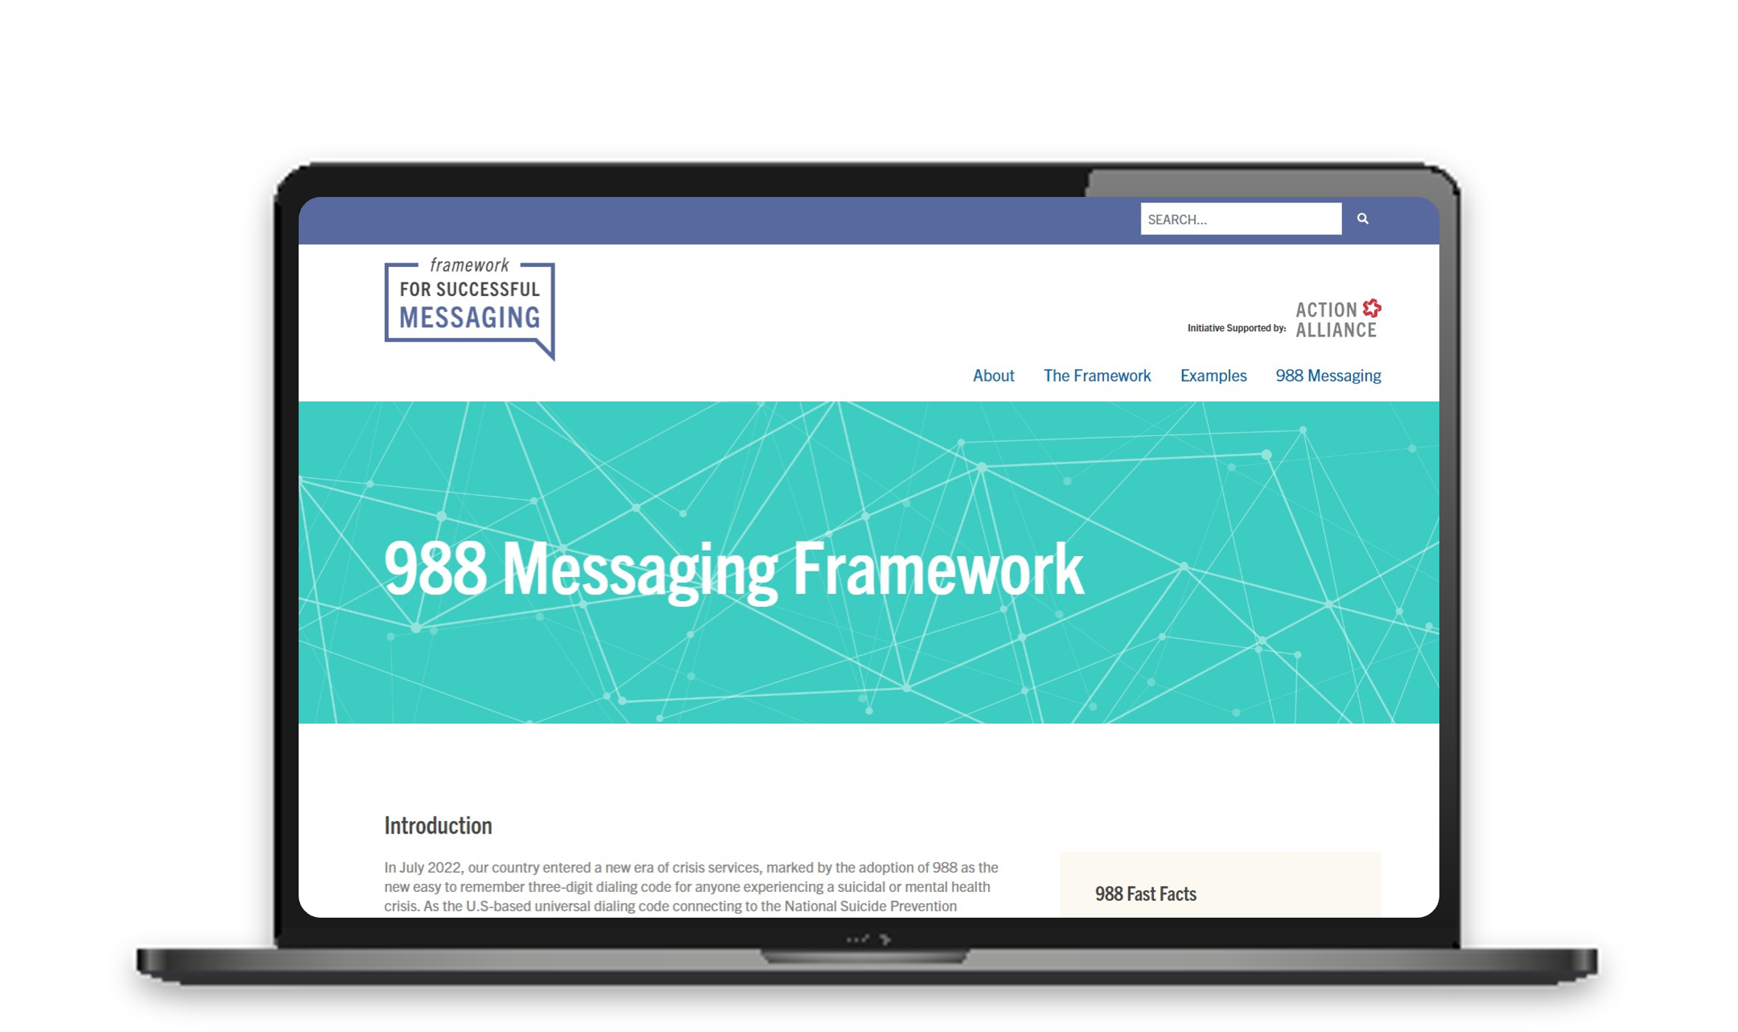
About the Nation’s 988 Messaging Framework
The Framework is:
Intended to serve as general guidance for those messaging about 988
Informed by messaging best practices, including the Action Alliance’s Framework for Successful Messaging online resource
Developed to complement a larger coordinated messaging strategy being developed by SAMHSA and Vibrant Emotional Health—as national leads for 988
Aligning our Messaging about 988: The Nation’s 988 Messaging Framework
9

Slide 10
Key Elements Used to Inform the Nation’s 988 Messaging Framework
The Action Alliance:
Conducted a Robust 988 Environmental Scan
of news articles and messaging resources/events to assess the existing landscape of 988 messaging and identify potential gaps and opportunities.
Issued a Comprehensive 988 Messaging Survey
to people working within the fields of mental health, suicide/suicide prevention, and substance use disorders to better understand the current and anticipated needs of the field when it comes to messaging about 988.
Convened a 988 Message Task Force and Engaged Various Partners
throughout the development process to ensure the Framework was informed by a broad range of perspectives. As national leads for 988, SAMHSA and Vibrant Emotional Health co-led the Task Force.
Aligning our Messaging about 988: The Nation’s 988 Messaging Framework
10

Slide 12
988 Messaging Framework Audience and Purpose
AUDIENCE
PURPOSE
The Framework is intended for you—anyone publicly messaging about 988. This may include state agencies, crisis centers, non-profit organizations, businesses, foundations, and others.
The Framework is intended to provide general guidance (a roadmap) about how to develop messaging about 988 to ensure it is effective, coordinated, and safe.
Aligning our Messaging about 988: The Nation’s 988 Messaging Framework
12

Slide 13
988 Messaging Framework Elements
MESSAGING CONSIDERATIONS
Tailoring 988 messaging for your audience
Amplifying your message
Understanding how 988 works
Knowing what 988 is… and what it is not
Following best practices
Aligning our Messaging about 988: The Nation’s 988 Messaging Framework
13
13

Slide 14
Messaging Considerations
Before messaging about 988, consider the following:
Work with local 988 implementers such as crisis centers to better understand the 988 infrastructure where you will be messaging (e.g., are mobile crisis teams available, if needed?).
Familiarize yourself with who operates the line and how calls, texts, chats into 988 are handled so you can accurately message about this and help eliminate potential barriers that may keep someone from using 988.
Understand that accessibility and inclusion are key 988, which is why it is be available via call, text, or chat and will offer interpretation services in over 150 languages.
TALK
Understanding How 988 Works
TEXT
CHAT
Aligning our Messaging about 988: The Nation’s 988 Messaging Framework
14
14
14
14

Slide 15
Messaging Considerations
To ensure you are messaging accurate information:
Understand how 988 works with other local supports, such as 911, 211, warmlines or other crisis call centers, to help avoid confusion.
Emphasize 911 and 988 are designed to complement one another to address the needs of an individual in crisis.
Reinforce what sets 988 apart from other 3-digit crisis lines such as 988 is staffed with trained counselors with experience in deescalating a crisis.
Reinforce that 988 is more than just a 3-digit number and is part of a larger opportunity for partners to reimagine their crisis service infrastructure and securing key services, such as crisis call centers, mobile crisis services, and crisis stabilization services.
Knowing What
988 Is…and What it Isn’t
Aligning our Messaging about 988: The Nation’s 988 Messaging Framework
15
15
15
15
15

Slide 16
Messaging Considerations
To ensure your messages are strategic, effective, and safe:
Utilize best practices, like the Framework for Successful Messaging, which provides research-informed guidance around messaging about suicide and suicide prevention.
Follow Best Practices
Be strategic
Use safe messaging
Follow a positive narrative by reinforcing solutions
Use data strategically
Aligning our Messaging about 988: The Nation’s 988 Messaging Framework
16
16
16
16
16
16

Slide 17
Messaging Considerations
Consider who makes up your key audience(s) before you develop messaging to make sure that your messages speak to their unique perspectives, experiences, and communications or language needs.
Utilize resources to create equitable messaging, such as the CDC’s Health Equity Guiding Principles for Inclusive Communication.
Collaborate with organizations that have extensive expertise working on-the-ground with various populations, such as tribal communities, Black or Latino communities, youth, LGBTQ populations, etc.
Tailoring 988 Messaging for Your Audience
Aligning our Messaging about 988: The Nation’s 988 Messaging Framework
17
17
17
17
17
17
17

Slide 18
Messaging Considerations
Partner with (local/national) champions to help get the word out to your audiences/within your communities through authoritative sources (e.g., faith leaders, media, decisionmakers) of information among your audiences.
Engage storytellers with diverse perspectives (e.g., gender, age, race, ethnicity, etc.) and lived experiences who can speak to the value of support and help to promote resources.
Connect with news media and encourage their use of best reporting practices, including the 988 Messaging Framework Media Toolkit.
Amplifying Your Message
Aligning our Messaging about 988: The Nation’s 988 Messaging Framework
18
18
18
18
18
18
18
18

Slide 20
Actions You Can Take
Utilize the 988 Messaging Framework
as you continue strengthening and contributing to the national narrative about 988.
Access the 988 Messaging Framework at 988messaging.org.
Promote the 988 Messaging Framework
so it’s utilized widely among the field and helping to achieve messaging alignment, consistency and coordination.
Access the promotional toolkit at 988messaging.org.
Share lessons learned
around how the 988 Messaging Framework is being used in order to share lessons and encourage use by others.
Email the Action Alliance team at info@theactionalliance.org.
Utilize other complementary messaging resources
developed by national 988 leads.
Email the Action Alliance team at info@theactionalliance.org.
Aligning our Messaging about 988: The Nation’s 988 Messaging Framework
20
20
20
20
20
20
20
20
20

Slide 21
It requires collaboration– across all sectors, communities, and institutions–to build the system of care that supports the needs of ALL people in the U.S. Now is the time for aligned messaging that spurs help-seeking and sustainable change.
Aligning our Messaging about 988: The Nation’s 988 Messaging Framework
21
21
21
21
21
21
21
21
21
21

Slide 22
Aligning our Messaging about 988: The Nation’s 988 Messaging Framework
22
22
22
22
22
22
22
22
22
22

